Slide 1




Excel
Training
for Beginners
SAID FAWZY
Manager of Information Center
Tendering Department
Arab Contractors

Slide 2


Excel
Training
for Beginners
SAID FAWZY
6
Copy, Paste, and Links

Slide 3






90%
90%
Using Cut and Copy
Exploring Paste Options
Pasting from the Clipboard
Linking Across Worksheets & Workbooks
Exam 6: Copy, Paste and Links

Slide 4
Excel
Training
for Beginners
SAID FAWZY
Using Cut and Copy
1

Slide 5
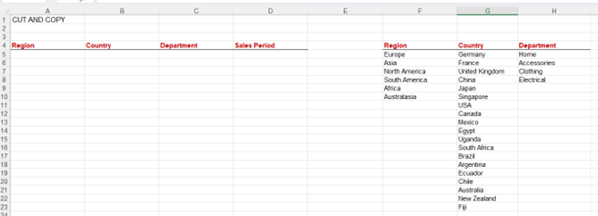
Using Cut and Copy
Using Cut and Copy

Slide 6
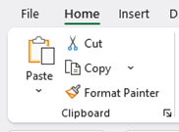
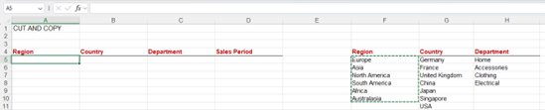
Using Cut and Copy
Move Data using Cut and Paste Commands

Slide 7
Using Cut and Copy
Move Data using Shortcut Keys

Slide 8
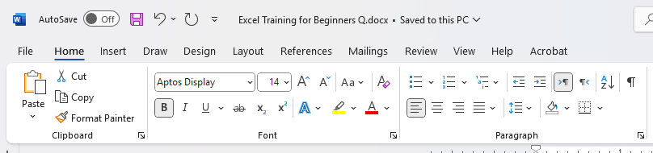
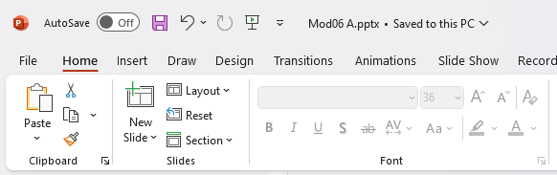
Using Cut and Copy
Copy and Paste with Other Applications

Slide 9
Excel
Training
for Beginners
SAID FAWZY
2
Exploring Paste Options

Slide 10
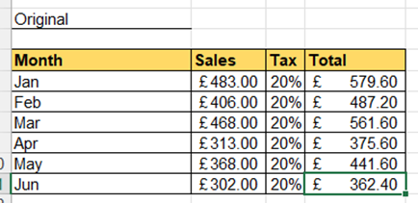
Exploring Paste Options

Slide 11
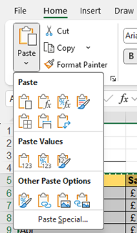

Exploring Paste Options
Paste Options

Slide 12
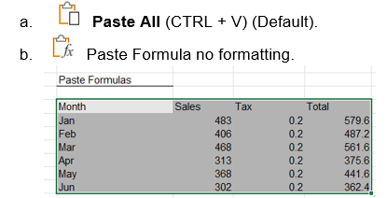
Exploring Paste Options
Paste Options

Slide 13
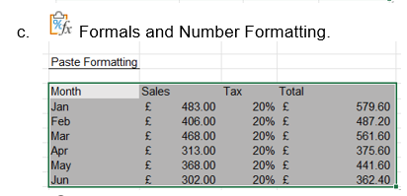
Exploring Paste Options
Paste Options

Slide 14

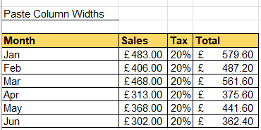
Exploring Paste Options
Paste Options

Slide 15
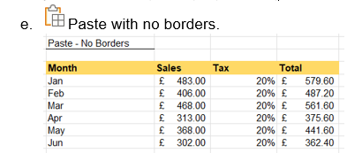
Exploring Paste Options
Paste Options

Slide 16
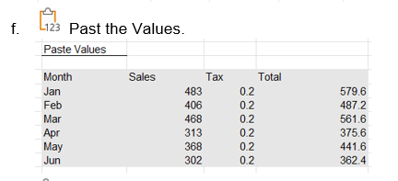
Exploring Paste Options
Paste Options

Slide 17
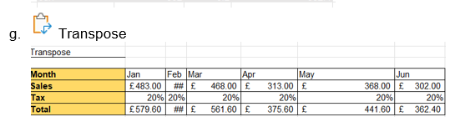
Exploring Paste Options
Paste Options

Slide 18
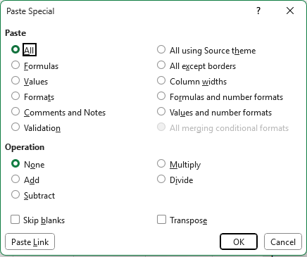
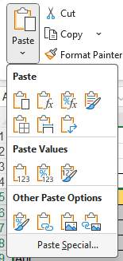
Exploring Paste Options
Paste Special

Slide 19
Excel
Training
for Beginners
SAID FAWZY
Pasting from the Clipboard
3

Slide 20
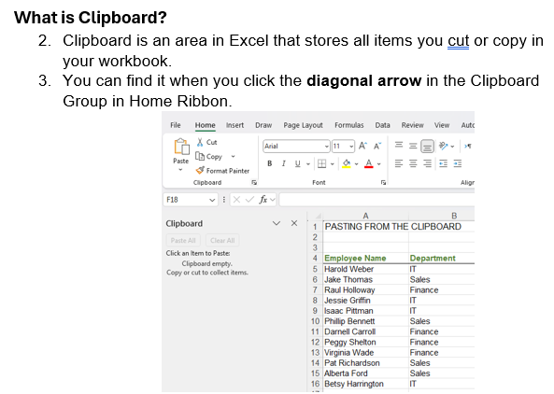
Pasting from the Clipboard
What is a Clipboard

Slide 21

Pasting from the Clipboard
What is a Clipboard

Slide 22
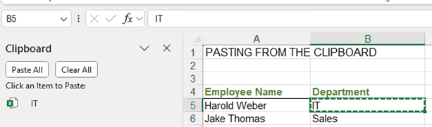
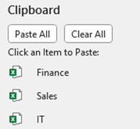
Pasting from the Clipboard
What is a Clipboard

Slide 23
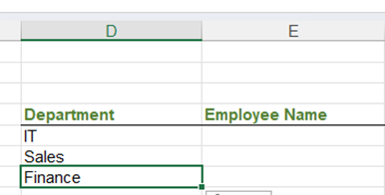
Pasting from the Clipboard
What is a Clipboard

Slide 24
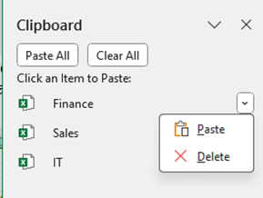
Pasting from the Clipboard
What is a Clipboard

Slide 25
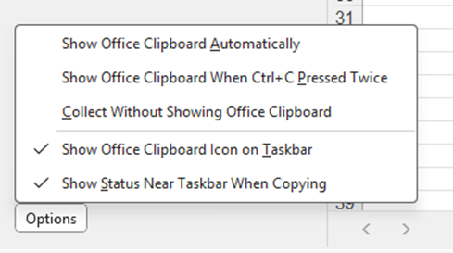
Pasting from the Clipboard
Clipboard Options

Slide 26


Pasting from the Clipboard
Clipboard Options

Slide 27
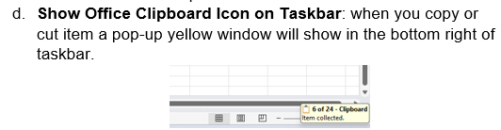
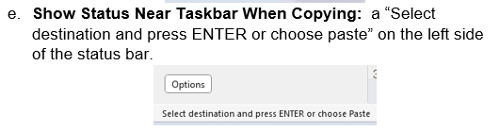
Pasting from the Clipboard
Clipboard Options

Slide 28
Excel
Training
for Beginners
SAID FAWZY
4
Linking Data Across Worksheets and Workbooks

Slide 29
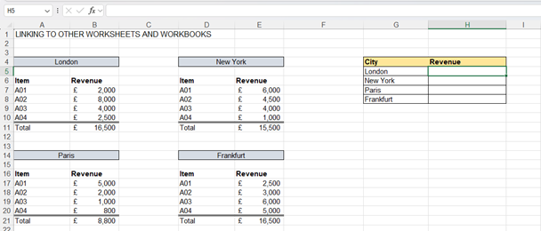
Linking Data Across Worksheets and Workbooks
Linking to the Same Worksheet

Slide 30
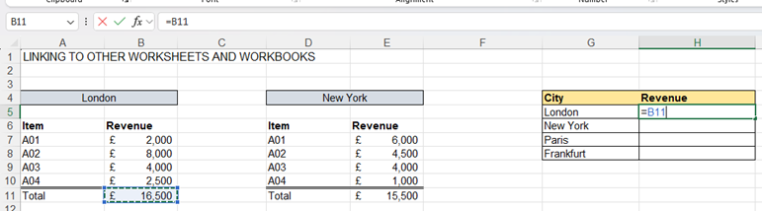
Linking Data Across Worksheets and Workbooks
Linking to the Same Worksheet

Slide 31


Linking Data Across Worksheets and Workbooks
Linking to Other Worksheet

Slide 32
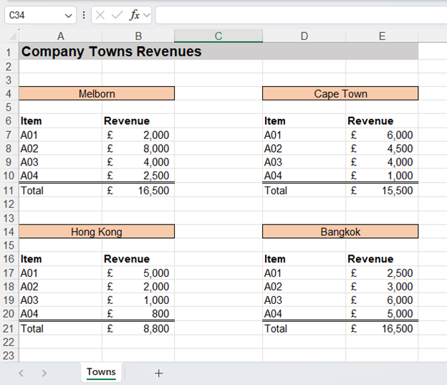
Linking Data Across Worksheets and Workbooks
Linking to Other Workbook

Slide 33
Linking Data Across Worksheets and Workbooks
Linking to Other Workbook

Slide 34
Excel
Training
for Beginners
SAID FAWZY
Exam 6
Copy, Paste, and Links

Slide 35
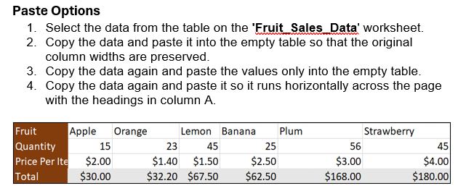
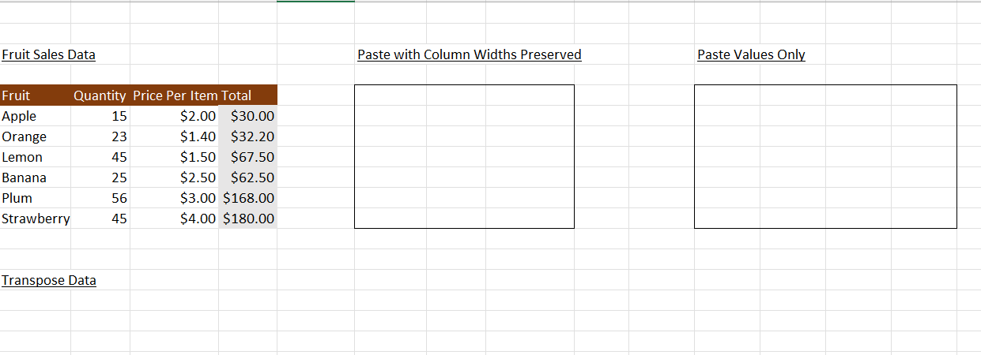
Exam 6: Copy, Paste, and Links

Slide 36
Exam 6: Copy, Paste, and Links

Slide 37
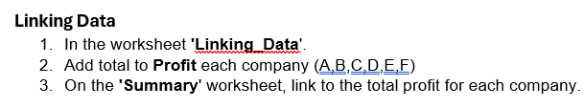
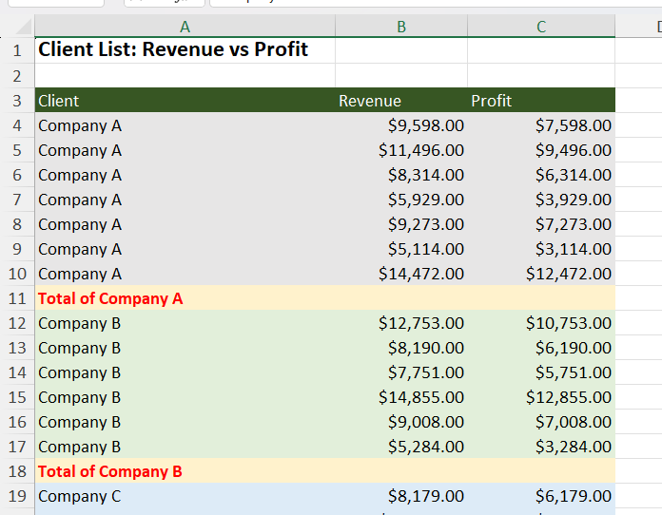
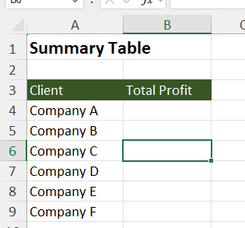
Exam 6: Copy, Paste, and Links

Slide 38



